Slide 1


Infosys Springboard
-
OBJECT RECOGNITION SYSTEM
-
Presentation 2024
OBJECT RECOGNITION SYSTEM
Presented by
Guided by
Anuradha Bhaskar
Shreya
KrishnaVardhan
saktivel
Anil Shaw - Infosys springboard member

Slide 2

Table of contents
Introduction
Image preprocessing
Preprocessing technquies examples
COCO Dataset Loader & Augmentation Pipeline
Model Training
Model Comparison
YOLOv5 Object Detection with Streamlit
System Architecture
Future Scope

Slide 3
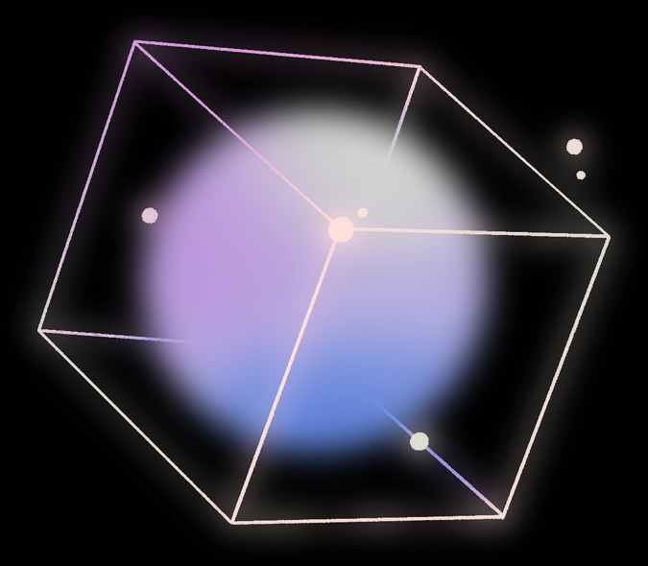

Introduction
Object recognition is a fundamental task in computer vision, enabling systems to detect, classify, and localize objects within images or videos. It involves analyzing visual data using advanced deep learning models, which process features to accurately identify objects and highlight them for further analysis. This technology is widely used to bridge the gap between visual information and automated decision-making.
we designed and implemented a web application to demonstrate object recognition in action. The application allows users to upload images or videos and generates outputs with detected objects clearly marked. Additionally, it supports real-time object recognition through a webcam, providing an interactive and efficient way to showcase the capabilities of object recognition systems.

Slide 4
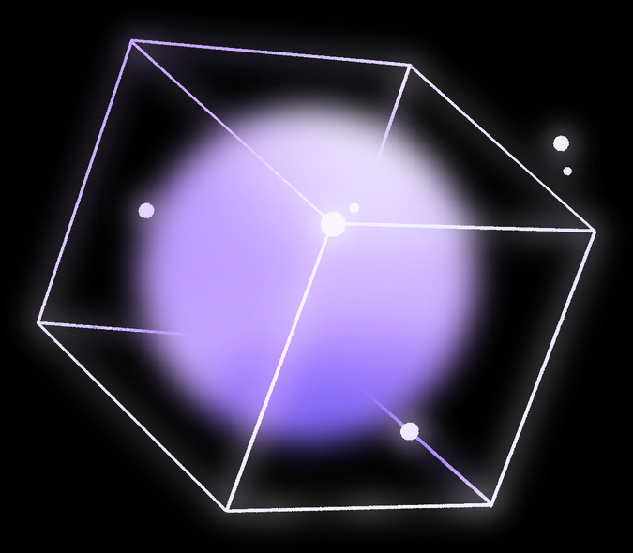
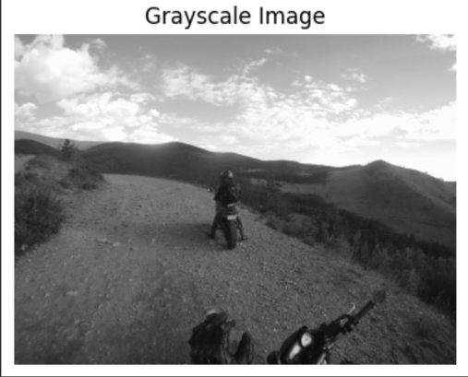
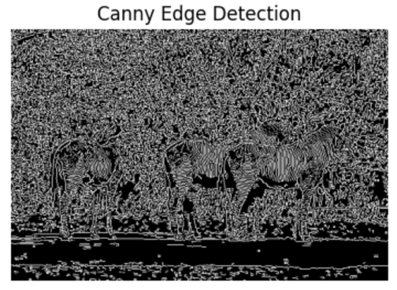
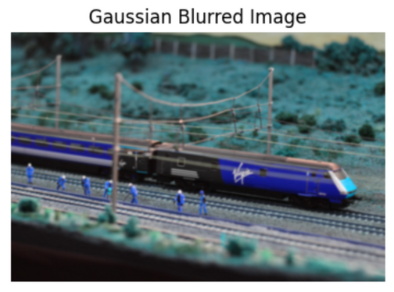
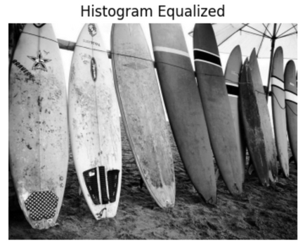
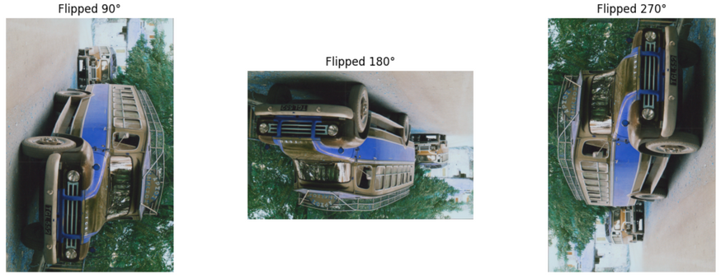
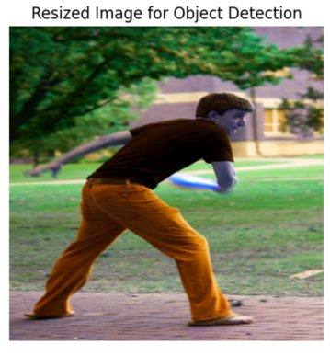
Image preprocessing
01
Grayscale Conversion
03
Canny Edge Detection
05
Gaussian Blur
Converts images to shades of gray, discarding color information.
Identifies regions of rapid intensity change, to outline objects for better feature extraction.
Reduces noise and unnecessary details, preparing the image for accurate edge detection.
02
Histogram Equalization
04
Image Flipping (Rotation)
06
Image Resizing
Enhances contrast and improves visibility in underexposed or overexposed images.
Creates varied orientations, increasing model robustness to object orientation changes.
Ensures uniform size for model compatibility, optimizing training and inference.
Resized image to 300x300
-
-

Slide 5


COCO Dataset Loader & Augmentation Pipeline
Custom Dataset Class
Augmentation Pipeline
DataLoader Features
Designed to process COCO-style datasets (images & annotations).
Groups annotations by image_id for quick access.
Converts images and bounding boxes to PyTorch tensors.
Library: Albumentations.
Techniques Applied:
Resizing (416x416), Horizontal Flip, Random Rotation.
Grayscale Conversion, Color Jitter, and Brightness Adjustment.
Gaussian Blur for diversity and Normalization with ImageNet stats.
Handles variable image sizes with a custom collate_fn.
Pads images to uniform dimensions for batch processing.
Configured with batch size = 6 and annotation support.
Benefits
Robust preprocessing for object detection.
Optimized for Faster R-CNN, Mask R-CNN, and YOLOv5 training.

Slide 6


Model Training
To achieve robust object detection, we trained three advanced models:
1. Faster R-CNN
Type: Two-stage object detection model.
Generates region proposals using a Region Proposal Network (RPN).
Classifies and refines proposals in the second stage.
Weaknesses: Slower inference speed due to its two-stage nature.
2. Mask R-CNN
Type: Extended Faster R-CNN for instance segmentation.
Detects objects and generates pixel-level masks for each object.
Adds a parallel branch to predict object masks along with bounding boxes.
Weaknesses: Slightly slower than Faster R-CNN due to the additional mask branch.
3. YOLO v5
Type: Single-stage object detection model.
Processes the entire image in one go to predict bounding boxes and class probabilities.
Adds a parallel branch to predict object masks along with bounding boxes.
Weaknesses: Slightly less accurate in detecting smaller objects compared to two-stage models.

Slide 7

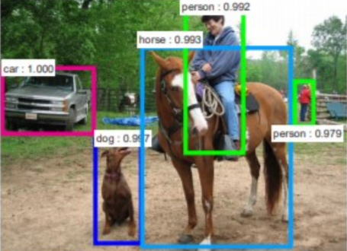
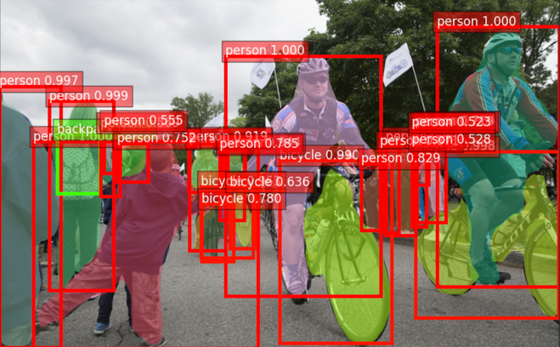
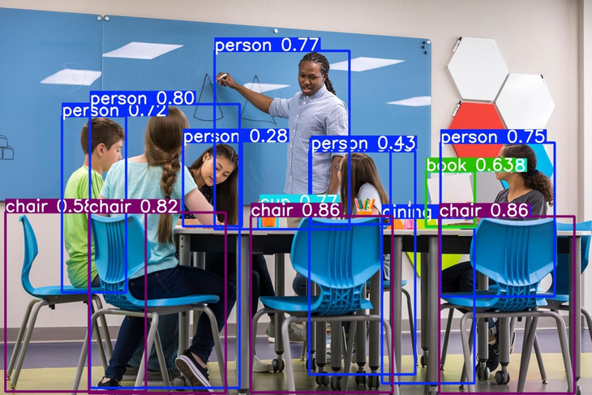
Model Comparison
Feature | Faster R-CNN | Mask R-CNN | YOLOv5
Output Types | Bounding Boxes + Class Labels | Bounding Boxes + Class Labels + Masks | Bounding Boxes + Class Labels
Key Strength | High detection accuracy | Instance segmentation | Real-time performance
Speed | Moderate (Two-stage detection) | Moderate (Mask prediction adds overhead) | High (Single-stage real-time model)
Use Case | General object detection tasks | Medical imaging, autonomous driving | Real-time systems (e.g., surveillance, drones)
Output

Slide 8

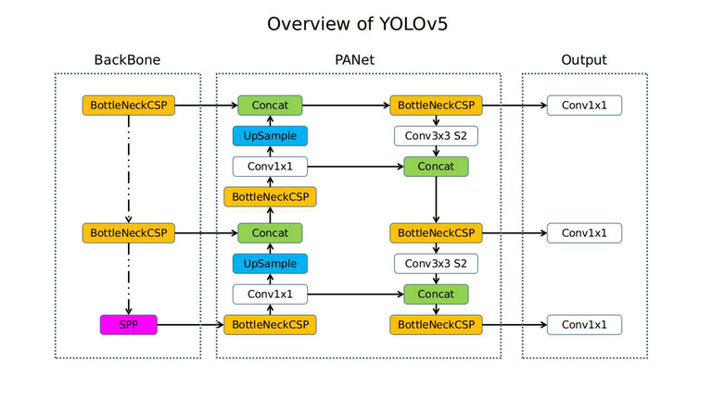
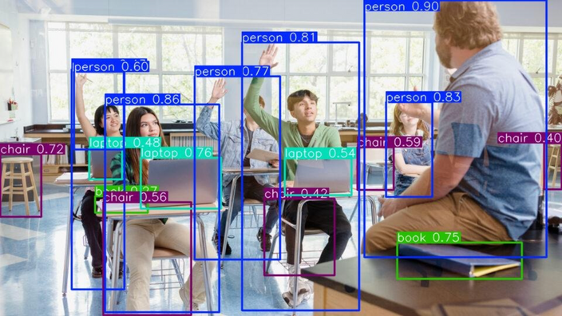
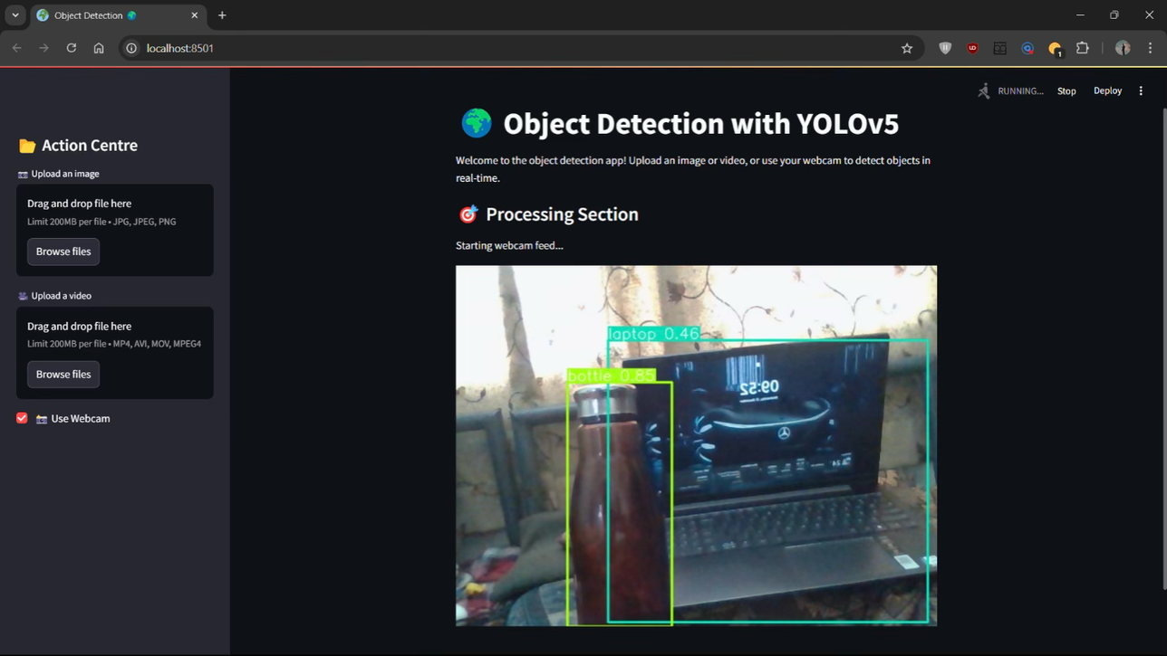
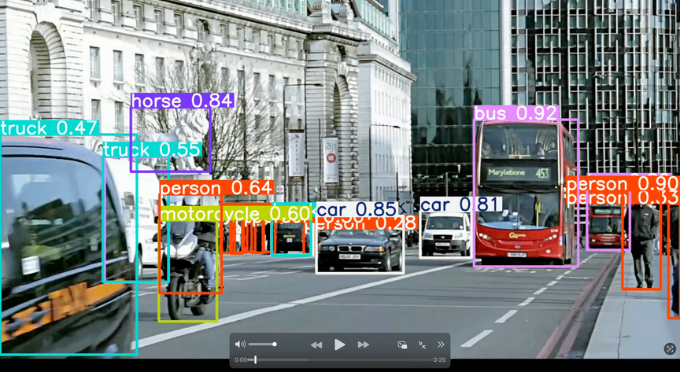
YOLOv5 Object Detection with Streamlit
YOLOv5: State-of-the-art real-time object detection model.
Streamlit: Interactive web app framework for easy UI creation.
Flask Backend: Handles image, video, and live webcam detection requests.
Output
Image detection
Live detection
Video detection

Slide 9
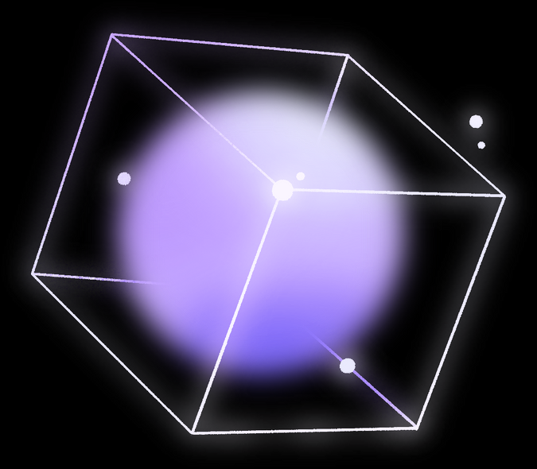
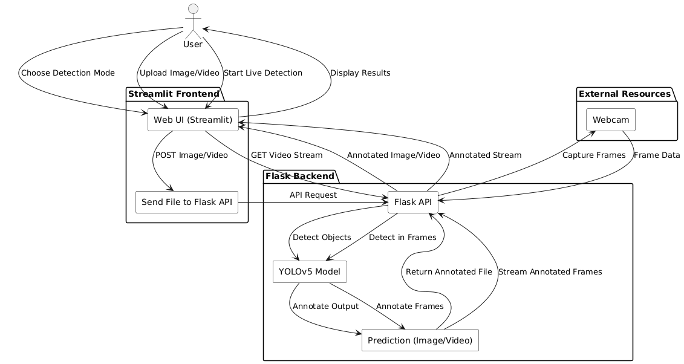
System Architecture

Slide 10

Future Scope
Enhanced Model Performance
Integration with Emerging Technologies
Broader Applications
Adopting newer YOLO versions for higher accuracy and faster detection.
Fine-tuning on custom datasets for specialized domains like healthcare or industrial automation.
Combining YOLOv5 with AI for predictive analytics and decision-making.
Using blockchain for secure, transparent detection logs.
Integrating with IoT for smart surveillance and automation.
Deploying in autonomous vehicles for safer navigation.
Expanding into medical diagnostics for automated X-ray and MRI analysis.
Revolutionizing retail and inventory management with automated object detection.

Slide 11

Infosys Springboard
-
Project
-
Presentation 2024
Thank You

